Slide 1


SMART INDIA HACKATHON 2025
TITLE PAGE
Problem Statement ID – 25002
Problem Statement Title- Smart Tourist Safety Monitoring & Incident Response System using Al, Geo-Fencing, and Blockchain-based Digital ID
Theme- Travel & Tourism
PS Category- Software
Team ID-
Team Name (Registered on portal)- Stakelock

Slide 2
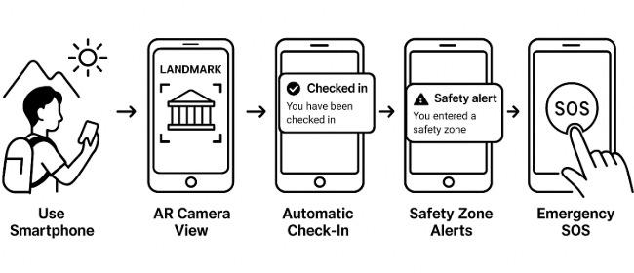
Samrakshanartham – Smart Tourist Safety, Identity & Incident Response Platform
Stakelock
Our proposed solution
AI-powered tourist safety with Digital Blockchain identity.
Active (real-time AI tracking + behavioral analysis) & Passive (QR-based check-ins) respecting user choice and privacy.
One-touch SOS with continuous camera/audio monitoring until authority intervention.
AI-Enhanced Geo-Fencing with auto check-in alerts, zone notifications, and personalized behavioral tracking for each tourist
Complete Ecosystem: Transport, Multilingual Support, guides, marketplace, AR navigation, gamified rewards.
How It Addresses the problem
Enables real-time AI tracking with anomaly detection in remote, high-risk areas.
Replaces manual tracking with blockchain-secured, tamper-proof digital IDs.
Provides multi-language support and verified marketplace to prevent scams and aid foreign tourists.
Employs AI-based behavioral analysis for predictive, personalized tourist safety alerts.
Integrates continuous SOS monitoring with live camera/audio streaming for rapid emergency response.
Innovation and Uniqueness
Live Evidence Streaming: Continuous camera/microphone monitoring during SOS with admin-controlled termination.
Smart Geo-Fencing Engine: Behavioral tracking using AI, Auto-generated alerts, zone-based notifications, and contextual safety recommendations.
QR-based Checkpoints: using QR codes for check-ins, offering a simple, non-intrusive alternative that avoids continuous tracking.
Community-Powered Safety: Real-time crowd-sourced alerts with AI verification system.
AR-Enhanced Navigation: Live camera overlays for safe routes, landmarks info, emergency beacons

Slide 3
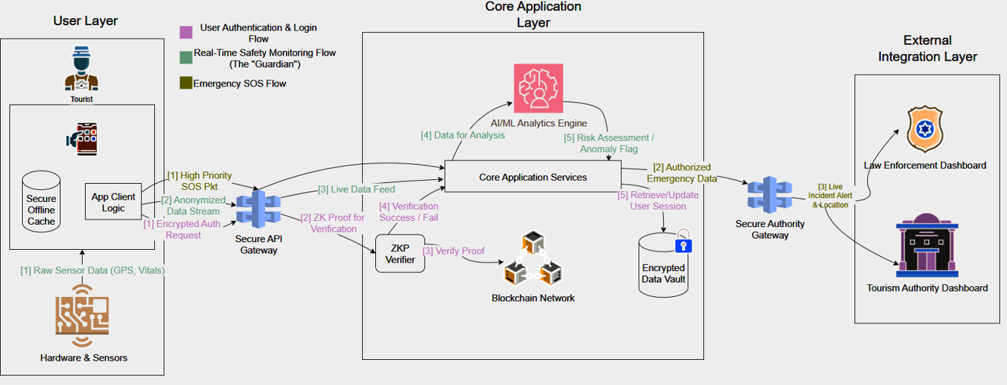
TECHNICAL APPROACH
Stakelock
Tech Stack
Mobile: Flutter (real-time streaming, offline-first)
Backend: Supabase (PostgreSQL + PostGIS), FastAPI (Python), Node.js
Blockchain: Solidity smart contracts AI/ML: Python, TensorFlow (anomaly detection, behavior & geo-learning)
Geo-Fencing: Polygon detection with behavioral tracking
Analytics: Real-time processing for visitor insights
Streaming: WebRTC, RTMP, Flutter native camera integration
Analytics & Decision Making Features
Behavioral Insights: Real-time analysis of popular zones, average dwell times, and visit frequency patterns
Space Optimization: Dynamic space utilization analysis for optimal resource allocation
Resource Allocation: Data-driven staffing, signage, and amenity deployment based on visitor flow
Bottleneck Identification: AI-powered detection and resolution of operational inefficiencies

Slide 4
FEASIBILITY AND VIABILITY
Stakelock
Technical Feasibility
Change Resistance
User Adoption Strategies
Schedule Feasibility
Mature Tech Stack
Availability of Documentation
Privacy Concerns
Data Privacy Measures
Phased Rollout
Scalable Infrastructure
Agile Development
Timely Delivery
Quantum Security
Network Dependency
Infrastructure Solutions
Legal Feasibility
Economic Feasibility
Alert Management Systems
FOSS Cost-Saving
False Alarms
Law Compliance
Tamper-Proof Records
Feasibility Analysis
Lower Operations
Heterogeneous Systems
Market Penetrable
Standardized APIs
Privacy Controls
Revenue Streams
Skilled DevOps
Stable Funding
Operational Feasibility
Adaptive Architecture
Changing Laws
Decentralized Management
Biased Data
Model Auditing
Workflow Integration
Multilingual Support
Challenges & Risks
Strategies to overcome these challenges
AI Automation

Slide 5
IMPACT AND BENEFITS
Stakelock
100%
Proactive AI Safety & Control
Traveler Empowerment
Detects anomalies and offers privacy options
Shifts from anxiety to confidence
75%
55%
Internal Group Tracking Hub
Group Coordination
Facilitates private group tracking and alerts
Eliminates stress, ensures safety
30%
32.5%
Emergency Response
50%
Instant & Verified SOS
17.5%
Provides multi-channel emergency alerts
Guarantees immediate, informed help
Impacts and benefits
25%
Economic & Social Protection
Financial and Social Protection
Prevents scams and ensures inclusivity
Protects tourists, removes barriers
0%
Intelligence-Led Operations
Proactive Policing
Uses data for resource deployment
Prevents crime, manages crowds
Immutable Evidence & Identity
Core features
Streamlined Processes
Tourist Safety Perception
Emergency Response Times
Tourist-Related Crimes
Tourism Revenue
Accelerates investigations, ensures justice
Offers blockchain-based identity verification
Enhanced safety perception among tourists
Decreased crimes like fraud and theft
Increased revenue due to global reputation
Enhanced National Brand
National Brand Elevation
Reduced response times for tourist incidents
Builds a reputation for safety and innovation
Attracts high-value tourism
Five-Year Projected Impact of the System
Strategic Digital Public Infrastructure
Strategic Asset Transformation
Creates a secure digital ecosystem
Turns safety cost into a national asset

Slide 6
RESEARCH AND REFERENCES
Stakelock
[1] C. He and C. Hua, “A blockchain-based framework for smart tourism,” Journal of Computer and Communications, vol. 11, no. 7, pp. 118–139, Jul. 2023. doi:10.4236/jcc.2023.117008
[2] A. Bajwa, “AI-based emergency response systems: A systematic literature review on smart infrastructure safety,” American Journal of Advanced Technology and Engineering Solutions, vol. 1, no. 1, pp. 174–200, Mar. 2025. doi:10.63125/xcxwpv34
[3] P. Priyadarshini et al., “Smart geo fencing,” International Journal for Research and Progress (IJRPR), Jun. 2025.link
[4] N. P. Caliston and G. C. Tabia, “Help me: An emergency response mobile application,” in Proc. ICITE 2021 Special Issue, 2021.link
[5] N. Nithya et al., “Real-time alert system based on crime area mapping,” 2025.doi: 10.17148/IJARCCE.2025.14496
[6] A. Antoneth et al., “The role of technology in enhancing tourist safety and security: Challenges and opportunities,” 2025.doi: https://dx.doi.org/10.47772/IJRISS.2025.914MG0094

